Slide 1
INDIAN BULLS
GIS BASED SECURITY INTERFACE
GANESH KUMAR.K
KARTHIKEYAN.R
MADHAN KUMAR.S
AJAY SOBI.S
VIGNESH.N

Slide 2
SYNOPSIS
INTRODUCTION
GIS BASED SECURITY SYSTEM
GSM SIM900A MODEM
BLOCK DIAGRAM
CONNECTIONS
WORKING
CONCLUSION

Slide 3
Introduction
The issue of security for women and children can be dealt by providing a safety process.
Adding GPS to find the location of the threatened person.
It provides self confident for the women.
The GIS based security interface can be used for these purposes . Using the main concept of tracking.
The exact location of the threatened person can be found and also used to make a call and send text messages to the police and also to the persons who are close to them.

Slide 4
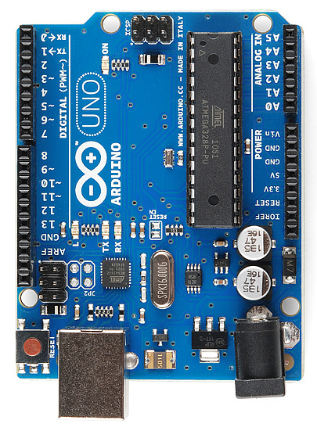
Arduino uno
Arduino is an open-source platform used for building electronics projects. ... Unlike most previous programmable circuit boards,
The Arduino does not need a separate piece of hardware (called a programmer) in order to load new code onto the board – you can simply use a USB cable.

Slide 5
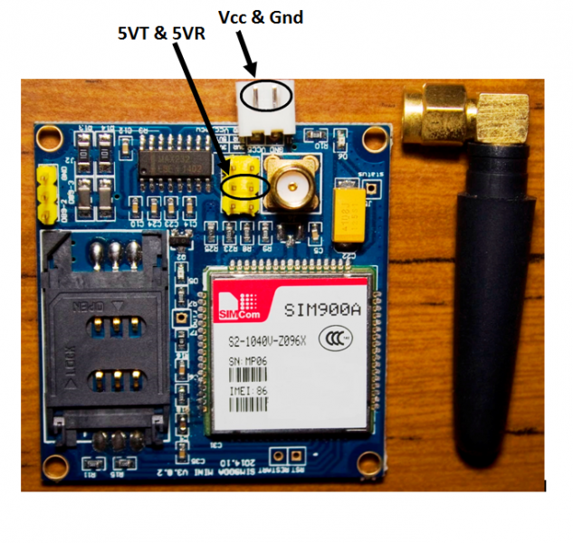
GSM SIM900A MODEM
This is an ultra compact and reliable wireless module. The SIM900A is a complete Dual-band GSM/GPRS solution in a SMT module which can be embedded in the customer applications.
Featuring an industry-standard interface, the SIM900A delivers GSM/GPRS 900/1800MHz performance for voice, SMS, Data, and Fax in a small form factor and with low power consumption.
With a tiny configuration of 24mmx24mmx3mm, SIM900A can fit in almost all the space requirements in user applications, especially for slim and compact demand of design.

Slide 6
BLOCK DIAGRAM
LOCATION TRACK
MESSAGE
A
R
D
U
I
N
0
U
N
O
VOICE CALL
G
S
M
M
O
D
U
L
E
KEY
POWER SUPPLY(12V)

Slide 7
CONNECTION
A
R
D
U
I
N
O
U
N
O
G
S
B
M
O
D
U
L
E
900A
D0
TX
D1
RX
TX
RX
GND
GND

Slide 8
working
The GIS based interface works with the help of the users cellID, Location area code ,mobile country code , signal strength.
This properties helps the user identifies the exact coordinate points of the network tower connected to the threatned phone
Which helps the user to identifiy the latitude and longitude of the location.
When the user tends to analysis this coordinates with the help of the google map,they can identify the exact address.
When this coordinates have been identified it can be sent to the respected person with the help of the ATD & AT+CMGS(AT-codes for dialing and messaging).

Slide 9
CONCLUSION
Thus the GIS based security interface has been constructed and tested and can be further developed to advanced technology to bring it into our day to day life.

